Slide 1
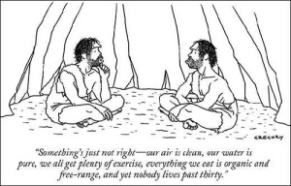
Hobbes II: The State of Nature
Politics 2A
Dr Carl Knight, Lecturer in Political Theory

Slide 2
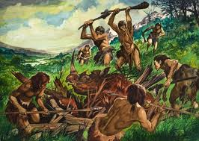
NATURAL CONDITION OF MANKIND
The circumstance people are in prior to political society - ‘the ill condition, which man by mere nature is actually placed in’ (Leviathan, ch. 13)

Slide 3

KEY FEATURES OF NATURAL CONDITION OF MAN
equality of strength - no one person can dominate
equality of ‘faculties of mind’ - people are similarly experienced and ‘prudence, is but experience’
vanity - every person thinks they’re wiser and more worthy than others

Slide 4
CONSEQUENCES OF NATURAL CONDITION OF MAN
competition due to ‘equality of hope’ – each thinks they can achieve their ends either alone, where they are superior, or through weight of numbers
pro-active defence resulting from ‘diffidence’ – that is, despair at vulnerability leads one to seek anticipatory ‘dominion over men’
breakdown in relations from ‘glory’ – every man values himself highly and punishes any sign of contempt or disregard with extortion.

Slide 5
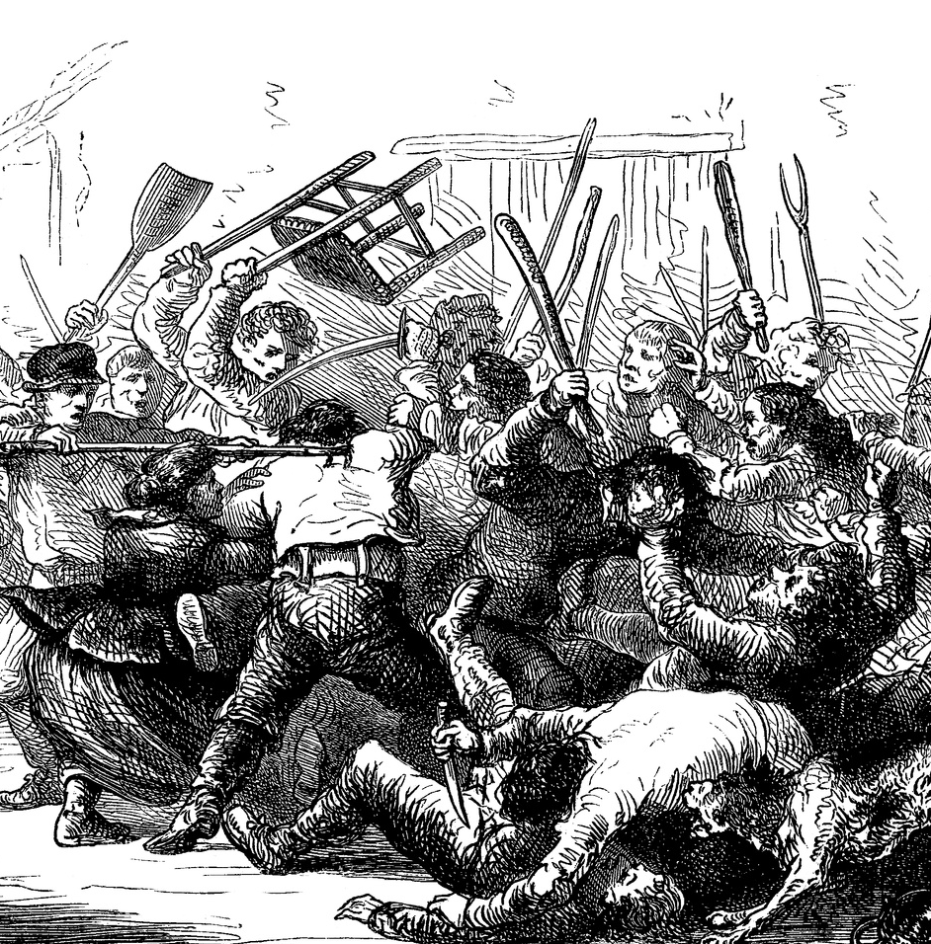
WAR!
Equality of hope, diffidence and glory leave each person with lack of knowledge about others’ intentions
This epistemic shortfall leads to ‘Warre of everyman against everyman’ for the sake of self-preservation

Slide 6
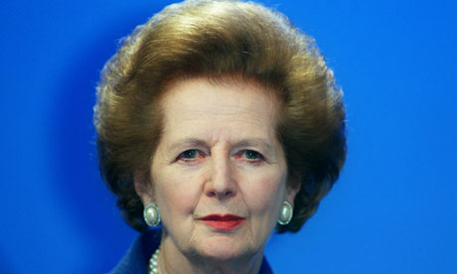
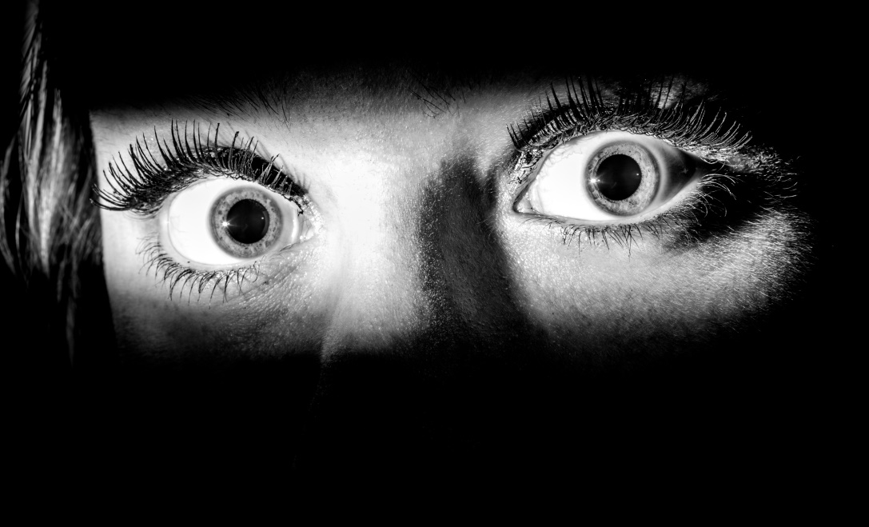
THE SEVERITY OF HOBBES’ STATE OF NATURE
There is no industry, cultivation, building, importing of goods; ‘no arts, no letters, no society; and which is worst of all, continual fear, and danger of violent death; and the life of man, solitary, poor, nasty, brutish, and short’.

Slide 7

WHY THINK THE STATE OF NATURE BE SO BAD?
People protect themselves even with laws – arm themselves, travel with company, lock doors
Hobbes also claimed (somewhat implausibly) that C17th Native Americans lived in state of nature
War of all against all existed, only to be stopped by sovereigns

Slide 8

ACTIVITY
Is the natural condition of mankind really a war of all against all?
You may wish to discuss Hobbes’ arguments about:
equality of hope
diffidence
glory
empirical evidence (e.g. security measures)

Slide 9

JUSTICE IN THE STATE OF NATURE
Horrible as the state of nature may be, it is not unjust: ‘The notions of right and wrong, justice and injustice, have there no place. Where there is no common power, there is no law: where no law, no injustice. Force, and fraud, are in war the two cardinal virtues’.
As support for this, Hobbes notes that the state of nature still exists between cities and kingdoms, which ‘endeavour as much as they can, to subdue, or weaken their neighbours, by open force, and secret arts, for want of other Caution, justly; and are remembered for it in after ages with honour’.

Slide 10
REALISM
Hobbes influenced realism, which sees international relations as ‘realpolitik’, shaped by an inevitable (and not unjust) conflict for power
Like Machiavelli, Hobbes is most associated with classical realism, which posits a relentless pursuit of power grounded in human nature (Morgenthau).
Hobbes is arguably also a precursor of structural realism (neorealism), which explains pursuit of power by the anarchic structure of international system (Waltz) - cf. Hobbes on international SoN

Slide 11
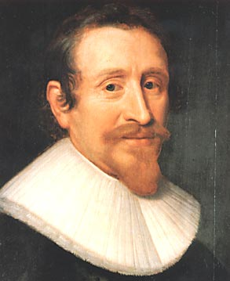
THE RIGHT OF NATURE
Influenced by Hugo Grotius
‘the Liberty each man hath, to use his own power, as he will himselfe, for the preservation of his own Nature; that is to say of his own Life; and consequently, of doing any thing, which in his own Judgement, and Reason, hee shall conceive to be the aptest means thereunto’ (Leviathan, ch. 14)
Anyone may do anything to defend herself, even kill without provocation - ‘every man has a Right to every thing; even to one anothers body’
Negative liberty – ‘absence of externall Impediments’

Slide 12

LAWS OF NATURE
Rational deductions from conditions
‘a Precept, or general Rule, found out by Reason, by which a man is forbidden to do, that, which is destructive of his life, or taketh away the means of preserving the same’
Alternatively: ‘convenient articles of peace, upon which men may be drawn to agreement’ (ch. 13)
The first law is ‘to seek peace, and follow it’.

Slide 13
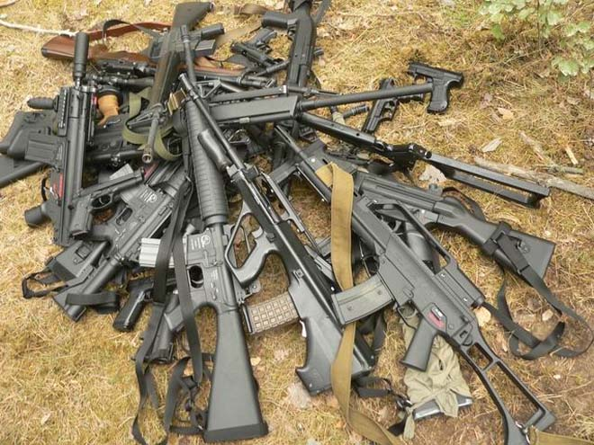
SECOND LAW OF NATURE
The second law is to give up the Right of Nature where others agree to do so: ‘That a man be willing, when others are so too … to lay down this right to all things; and be contented with so much liberty against other men, as he would allow other men against himselfe’ (cf. golden rule)
Crucial that both parties lay down Right of Nature. As long as both retain it, they are at war; if only one person gave it up, he would ‘expose himself to Prey’

Slide 14

CONTRACTS
‘mutuall transferring of right’ - ‘Signes’ express/infer
Here is the slim moral content of Hobbes’ theory: when a man gives up the right, ‘then is he said to be OBLIGED, or BOUND, not to hinder those, to whom such Right is granted, or abandoned, from the benefit of it: and that he OUGHT, and it is his DUTY, not to make VOYD that voluntary act of his own: and that such hindrance is INJUSTICE’.
Consent-based/voluntarist morality (keep promises)

Slide 15
COVENANTS
Contract where agreed thing is delivered in future.
In SoN must even perform ‘Covenants entred into by fear’: if one agrees to pay a ransom, one must pay it.
Shows Hobbes puts great weight on agreements. But hard to reconcile his claims that (1) there’s no injustice in the state of nature, (2) breaching covenants is definition of injustice (cf. 3rd law), and (3) contracts can be breached in the state of nature.
‘Suspended’ obligations in SoN because others may not act on their obligations (Warrender)?

Slide 16
INALIENABLE RIGHTS
Although the full Right of Nature – the right to everything in the world – can be laid down, some rights are always retained.
Rights to resist attack and imprisonment, and to refuse to testify against oneself, family, benefactor.
All voluntary acts are intended to further actor’s good, so no act can bind him to accept danger.
Again, this might be seen as involving moral judgment on Hobbes’ part – what about relativism?

Slide 17
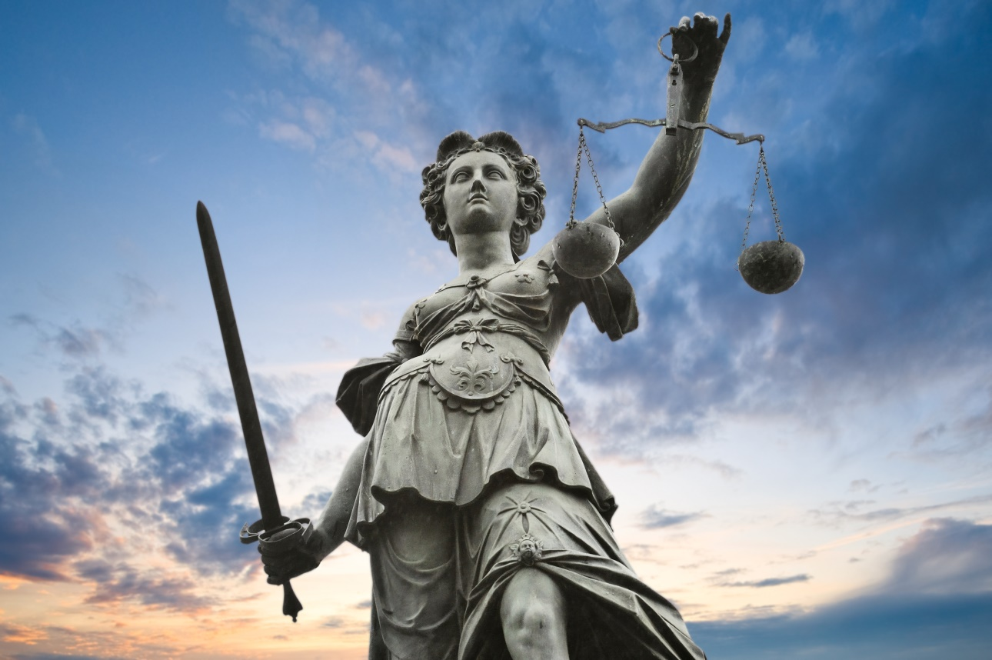
COMPLIANCE
Signes can’t ensure performance of obligations due to ‘temptations of avarice, ambition, lust’
‘The force of words, being … too weak to hold men to the performance of their covenants’
‘passion to be reckoned upon is fear’ (cf Machiavelli)
Fear of other men – civil society – is most powerful

Slide 18
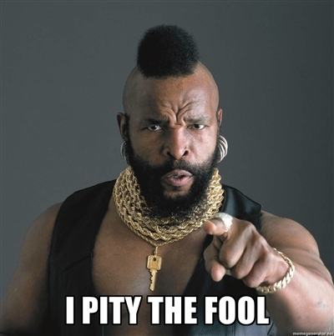
THE FOOLE
Couldn’t it be in self-interest to break covenants?
This ‘Foole’ wouldn’t be admitted to Commonwealth if he’s detected & can’t assume he won’t be detected
Must assume detection and destruction by society

Slide 19
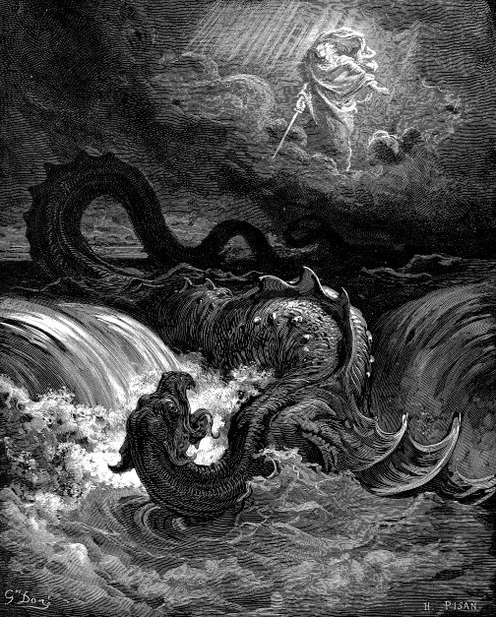
Next Lecture: The Leviathan

